Slide 1
Comparison of Container Technology Systems for MapReduce Clusters of Different Cloud Providers
Team Name : Delta
Team Members:
Balaji sai, Anuj Shah, Parth Shah, Enam Shah

Slide 2
Project Outline
There are various cloud providers who offer container technology present in the market. So the purpose of our project is to compare and analyze containers of different cloud providers by using different MapReduce Benchmarks in Hadoop.
In all the cloud providers, containers instances are launched on Virtual Machine (VM). So, the containers have the VM overhead time.
But using containers, it is easier to scale up to many container instances.
Also there are many other advantages of using Containers like Increased productivity, Rapid deployment, easy to ship.

Slide 3
Project Outline (Contd)
We will conduct experiments using different MapReduce benchmarks to stress Hadoop clusters over distinct situations on the container-based virtualization systems.
The approach we took to do this is by conducting experiments on two well known evaluation perspectives:
• Micro Benchmark
• Macro Benchmark

Slide 4
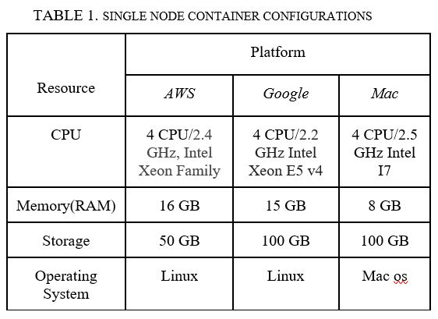
CONFIGURATIONS
Notes:
t2Xlarge

Slide 5
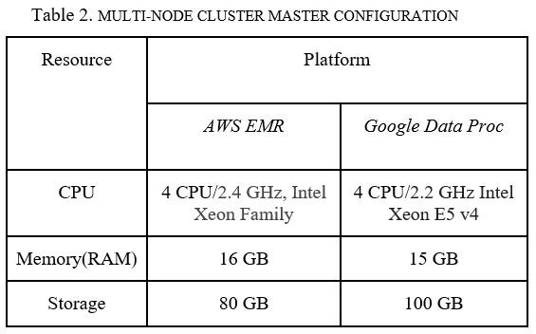

Slide 6
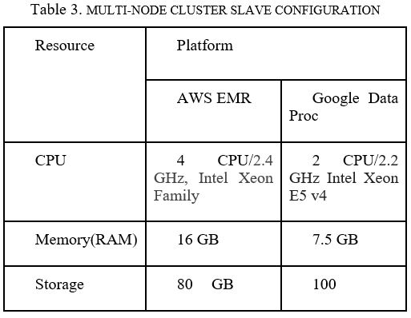

Slide 7
Micro BenchMarks

Slide 8
Micro-Benchmarks
Micro-benchmark is used to test the basic components of the Hadoop system. By micro-benchmarks it is possible to measure the performance of basic components before evaluating the system as a whole. Having the micro-benchmarks results, the macro-benchmarks is where we would evaluate the system as whole.
Various micro-benchmarks that we have used are :
1. TestDFSIO Benchmark
2. NameNode Benchmark (NNBenchmark)
3. MapReduce Benchmark (MRBenchmark)

Slide 9
TestDFSIO BenchMark
The TestDFSIO is a read and write test for HDFS
It uses one map task per file
It gives an idea of how fast the cluster is terms of I/O
Helpful in stress testing HDFS
It discovers network performance bottleneck
To shake out the hardware, OS and Hadoop setup of your cluster machines (particularly the NameNodes and the DataNodes)

Slide 10
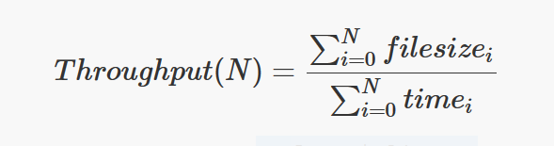
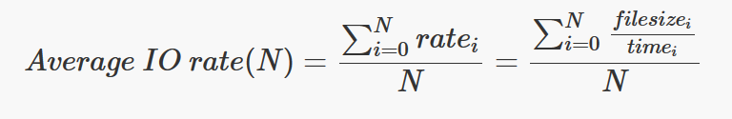
TestDFSIO BenchMark
The Throughput and Average IO rate is calculated using the below formulae :
Where, N is the number of map tasks

Slide 11
TestDFSIO: Write Test
Generate 8 files of size 1GB for a total of 8GB
Command:
$ bin/hadoop jar share/hadoop/mapreduce/hadoop-mapreduce-client-jobclient-2.7.1 jar TestDFSIO –write –nrFiles 8 –fileSize 1000
TestDFSIO is designed to use 1 map task per file
Write output to /benchmarks/TestDFSIO
(1:1 mapping from files to map tasks)

Slide 12
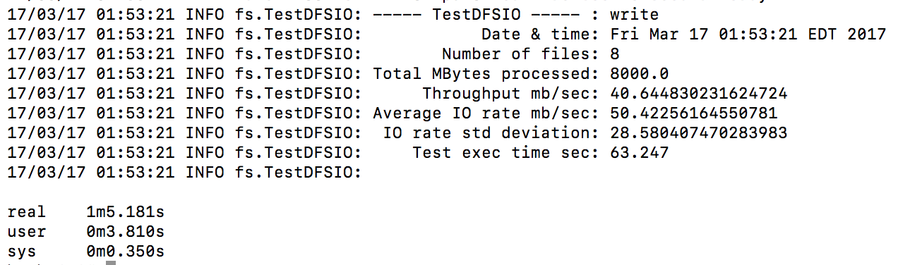
TestDFSIO: Write Output (8Gb)

Slide 13
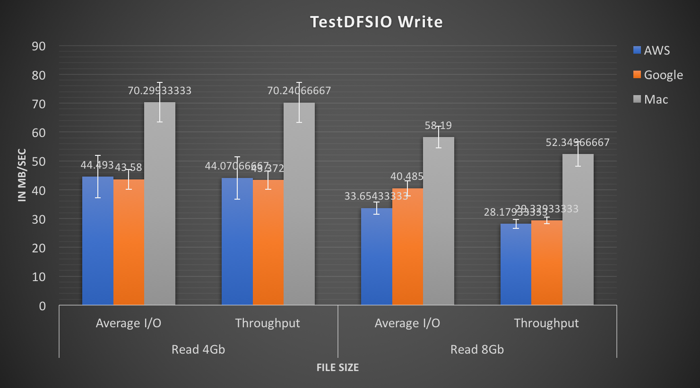

Slide 14
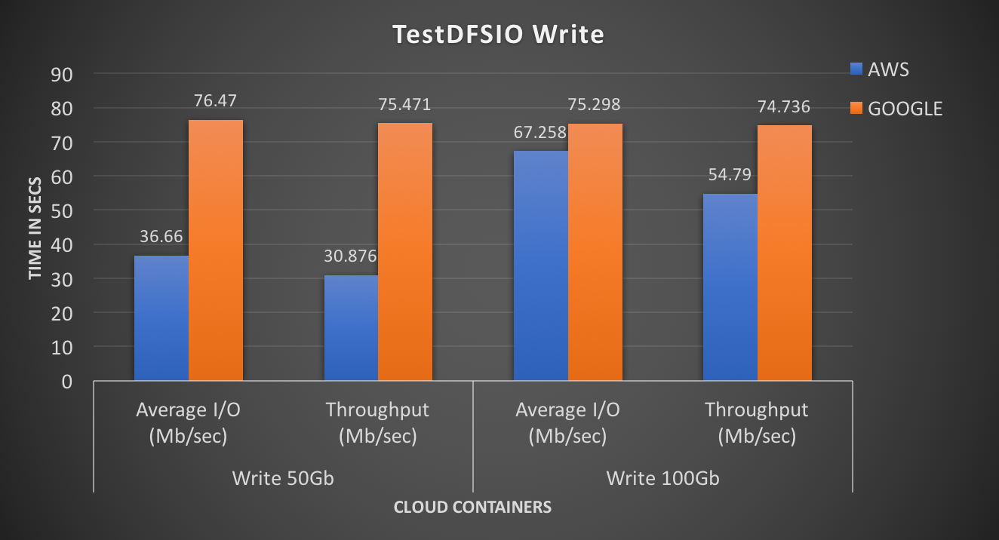
Cluster
Cluster

Slide 15
TestDFSIO: Read test
Read 8 input files, each of size 1 GB
Command:
$ bin/hadoop jar share/hadoop/mapreduce/hadoop-mapreduce-client-jobclient-2.7.1 jar TestDFSIO -read -nrFiles 8 -fileSize 1000

Slide 16
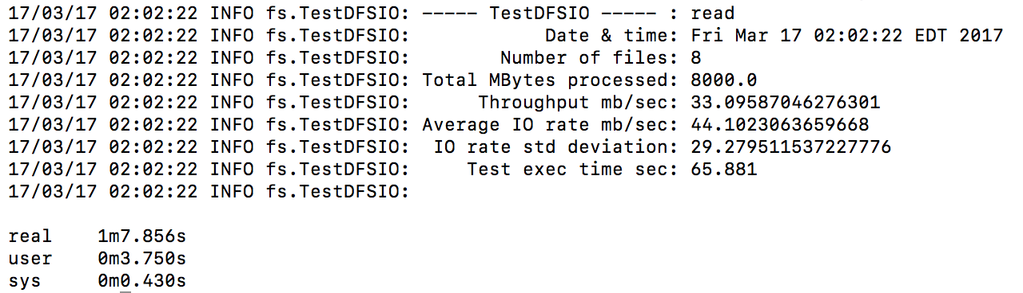
TestDFSIO: Read Output (8Gb)

Slide 17
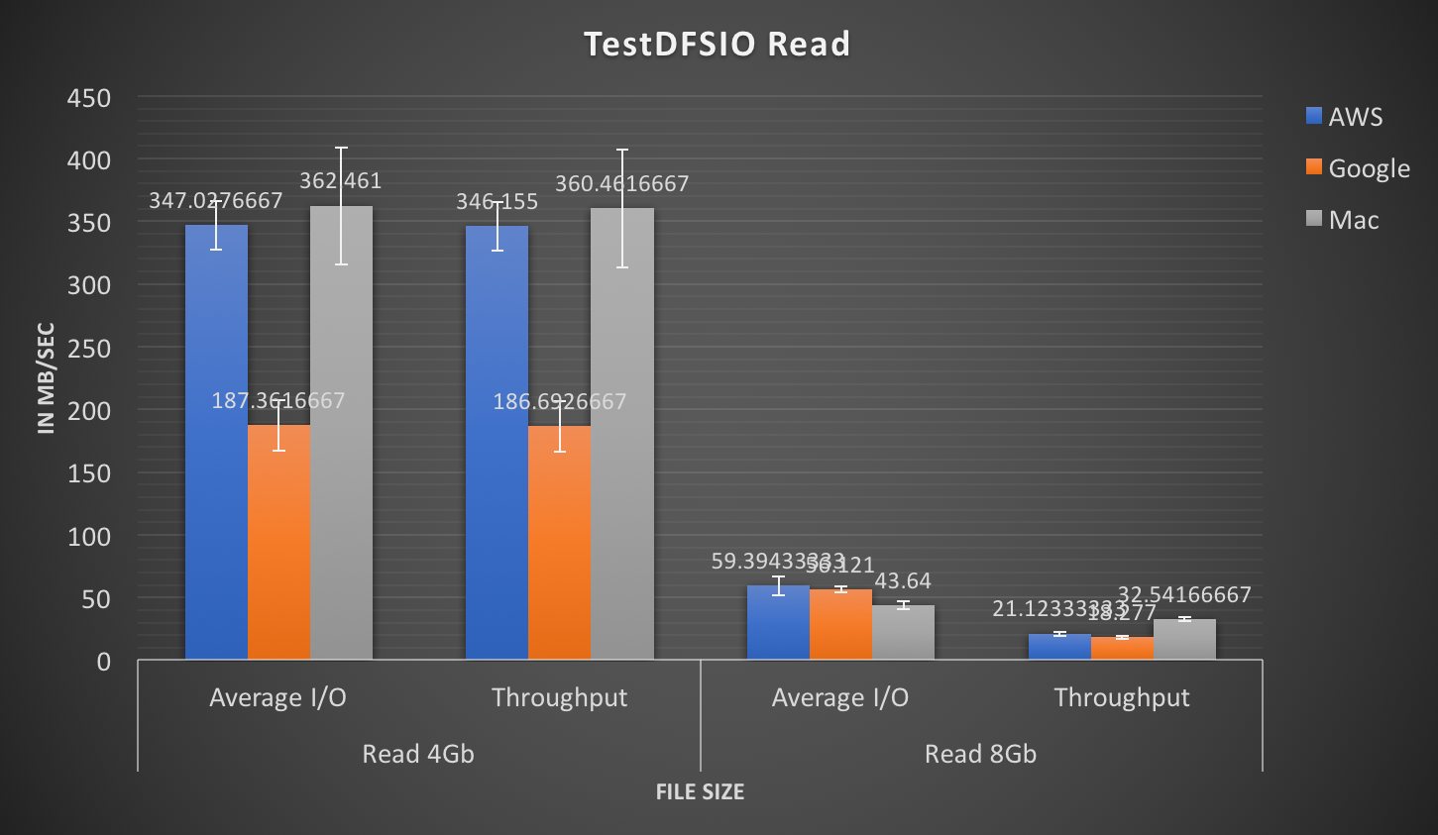


Slide 18
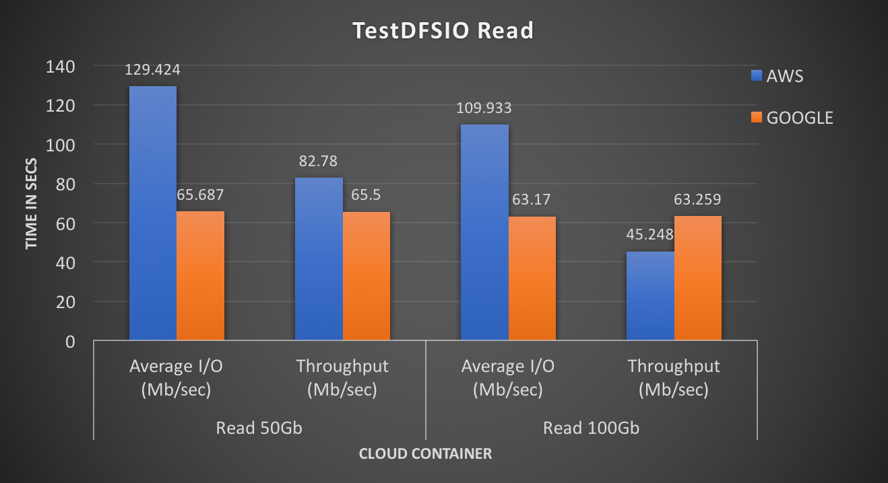
Cluster

Slide 19
NameNode Benchmark
Generates: a lot of HDFS-related requests with normally very small “payloads” for the sole purpose of putting a high HDFS management stress on the NameNode
Purpose: put a high HDFS management stress on the NameNode.
In Hadoop clusters, the NameNode keeps the directory tree of all files in HDFS and locations of the files across the multiple DataNodes and the NNBench runs a test for the NameNode with some load.
The benchmark can simulate requests for creating, reading, renaming and deleting files on HDFS.
In order to analyse the behaviour of NameNode component while dealing with huge amount of HDFS – related requests we choose NN Benchmark. This benchmark is considered to be the load test for HDFS files where we create, write, open, read and delete files.
We performed types of simulation such as first we create and write the file and then we will open and read the file.

Slide 20
Command
$ time bin/hadoop jar share/hadoop/mapreduce/hadoop-mapreduce-client-jobclient-2.7.1.jar nnbench -operation create_write \ -maps 12 -reduces 6 -blockSize 1 -bytesToWrite 1000 -numberOfFiles 1000 \ -replicationFactorPerFile 2 -readFileAfterOpen true \ -baseDir /benchmarks/NNBench-`hostname -s`

Slide 21
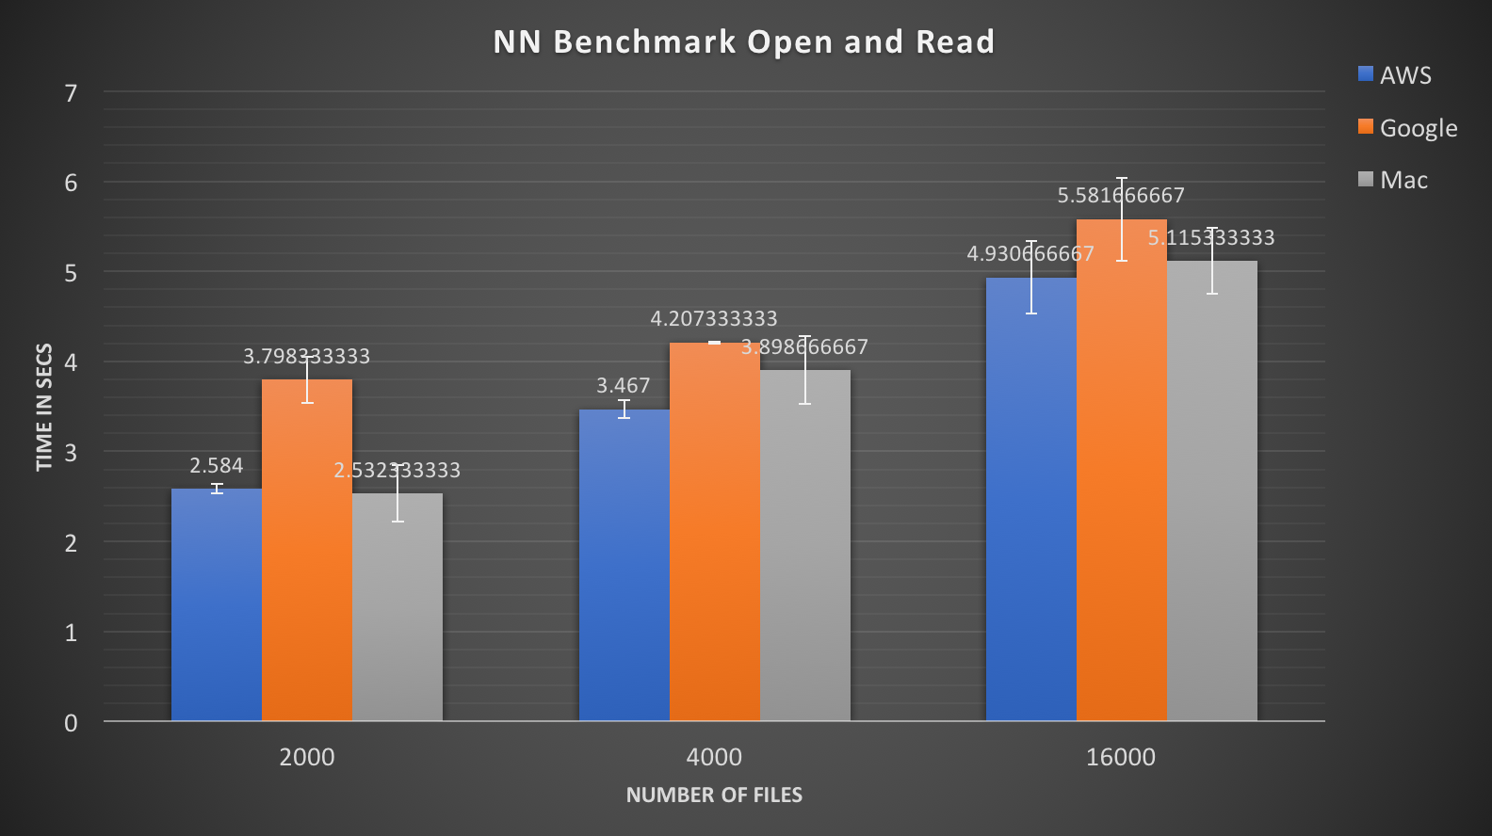

Slide 22
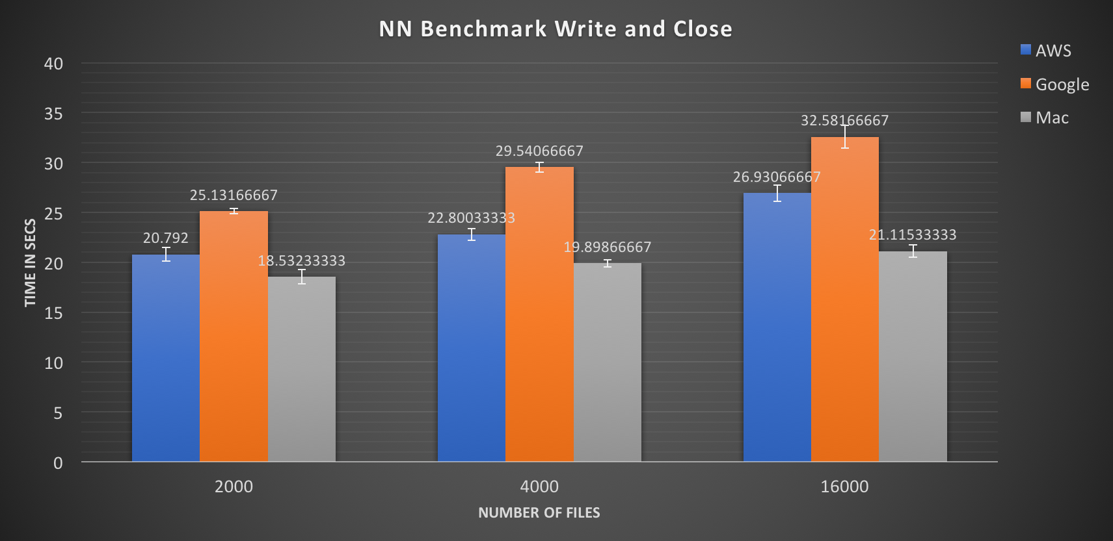

Slide 23
MapReduce Benchmark
MRBench loops a small job a number of times.
This benchmark stresses the MR layer to identify how efficiently it works while dealing with enormous job requests.
checks whether small job runs are responsive and running efficiently on the cluster
It focuses on the MapReduce layer
impact on the HDFS layer is very limited.

Slide 24
Command
To run a loop of 250 small test jobs
$ time bin/hadoop jar share/hadoop/mapreduce/hadoop-mapreduce-client-jobclient-2.7.1.jar mrbench -numRuns 250

Slide 25
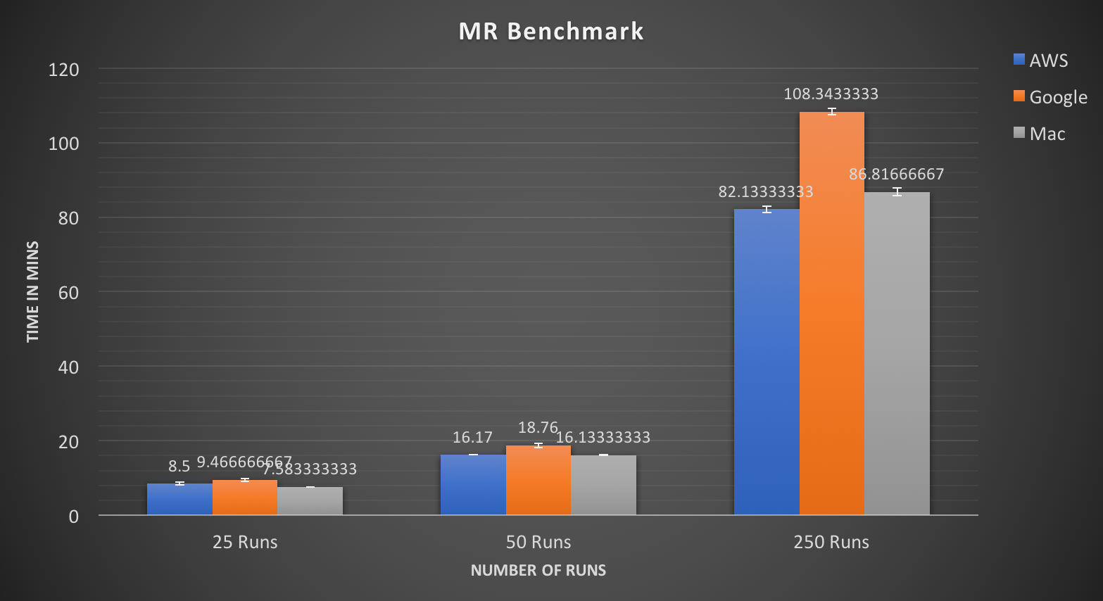

Slide 26
MacroBenchMarks

Slide 27
Macro-benchmarks
Macro-benchmarks stress out numerous segments of a framework and can typically give more critical outcomes, as it certainly incorporates the segments before assessed by small scale benchmarks.
Various macro-benchmarks that we have used are :
TeraSort Benchmark
WordCount

Slide 28
TeraSort Benchmark
Goal: Sort (200mb/10gb) of data (or any other amount of data) as fast as possible.
Terasort is the well-known benchmark to identify how fast a Hadoop cluster is.
It is a benchmark that combines testing the HDFS and MapReduce layers of an Hadoop cluster
TeraSort is helpful to determine whether your map and reduce slot assignments are sound (as they depend on the variables such as the number of cores per TaskTracker node and the available RAM
Notes:
TeraValidate creates one map task per file in TeraSort’s output directory. A map task ensures that each key is less than or equal to the previous one. The map task also generates records with the first and last keys of the file, and the reduce task ensures that the first key of file i is greater than the last key of file i-1. The reduce tasks do not generate any output if everything is properly sorted. If they do detect any problems, they output the keys that are out of order.

Slide 29
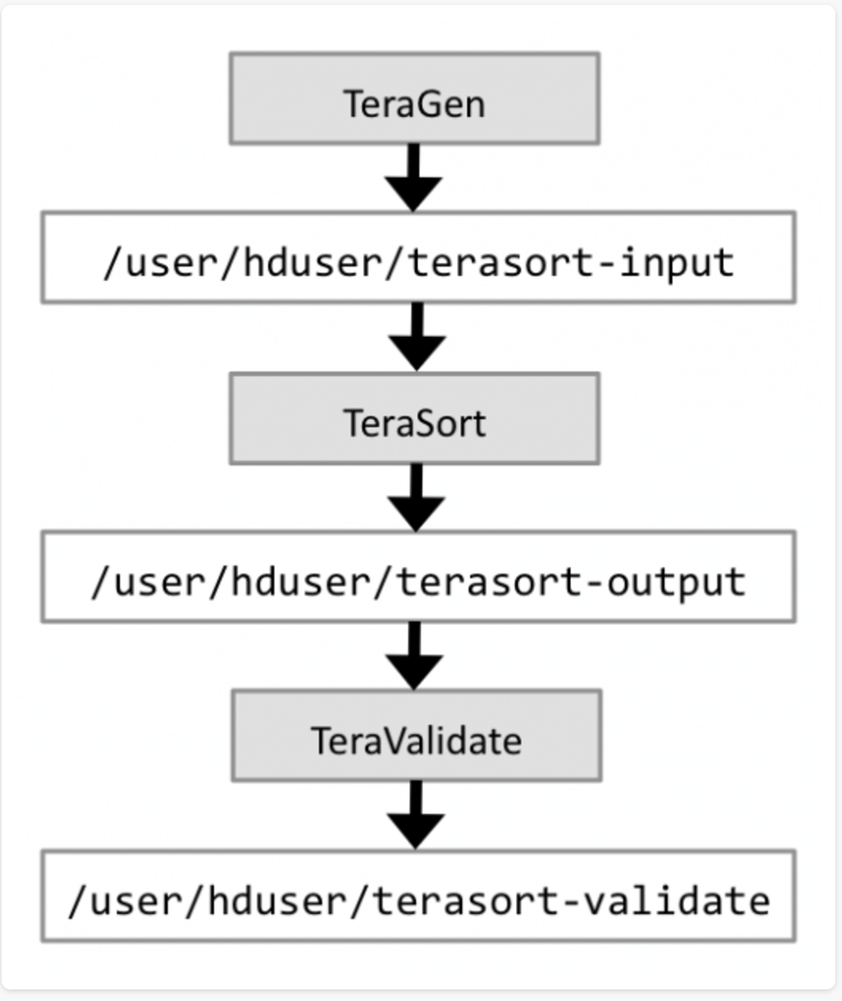
TeraSort Workflow
A full TeraSort benchmark run consists of the following three steps:
1. Generating the input data via TeraGen.
2. Running the actual TeraSort on the input data.
3. Validating the sorted output data via TeraValidate.
Notes:
The terasort benchmark sorts a specified amount of randomly generated data. This benchmark provides combined testing of the HDFS and MapReduce layers of a Hadoop cluster. A full terasort benchmark run consists of the following three steps:
Generating the input data via teragen program.
Running the actual terasort benchmark on the input data.
Validating the sorted output data via the teravalidate program.
In general, each row is 100 bytes long; thus the total amount of data written is 100 times the number of rows specified as part of the benchmark (i.e., to write 100GB of data, use 1 billion rows). The input and output directories need to be specified in HDFS. The following sequence of commands will run the benchmark for 50GB of data as user hdfs. Make sure the

Slide 30
Commands:
TeraGen:
$ time bin/hadoop jar share/hadoop/mapreduce/hadoop-mapreduce-examples-2.7.1.jar teragen 100000000 /benchmark/terasort-input
TeraSort:
$ time bin/hadoop jar share/hadoop/mapreduce/hadoop-mapreduce-examples-2.7.1.jar terasort /benchmark/terasort-input /benchmark/terasort-output
TeraValidate:
$ time bin/hadoop jar share/hadoop/mapreduce/hadoop-mapreduce-examples-2.7.1.jar teravalidate /benchmark/terasort-output /benchmark/terasort-validate

Slide 31
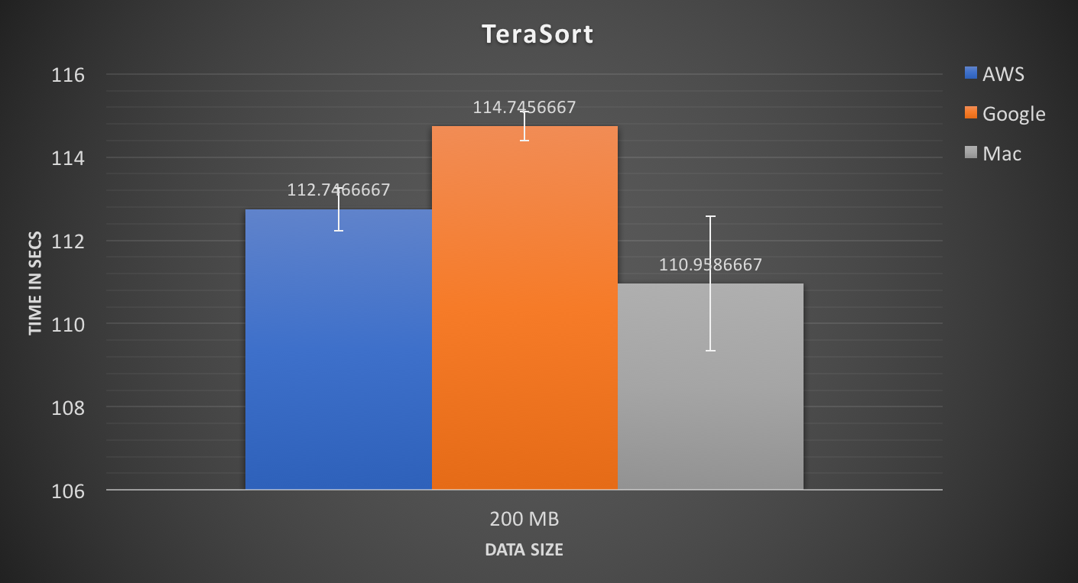

Slide 32
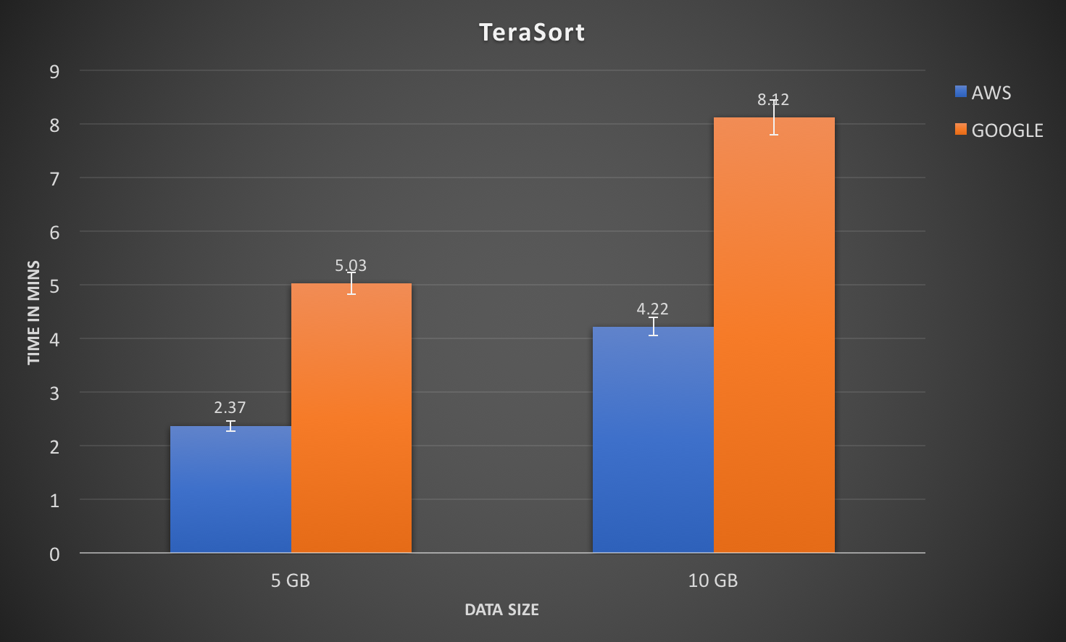
Cluster
Cluster

Slide 33
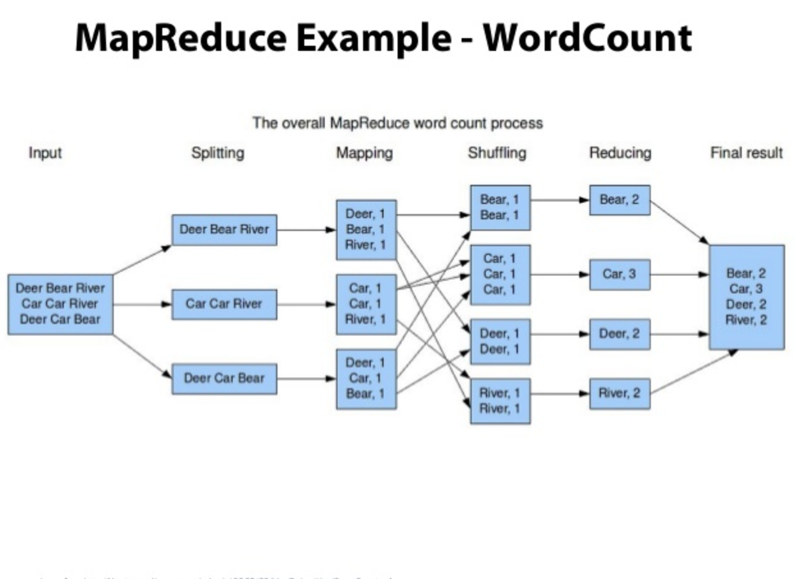
Word Count
Notes:
kfjlskhlksfl The Map class takes lines of text that are fed to it (the text files are automatically broken down into lines by Hadoop-
WordCount.java will automatically compute the word frequency of all text files found in the HDFS directory you ask it to process.
The Map class takes lines of text that are fed to it (the text files are automatically broken down into lines by Hadoop--No need for us to do it!), and breaks them into words. Outputs a datagram for each word that is a ( String, int ) tuple, of the form ( "some-word", 1), since each tuple corresponds to the first occurence of each word, so the initial frequency for each word is 1.
The reduce section gets collections of datagrams of the form [( word, n1 ), (word, n2)...] where all the words are the same, but with different numbers. These collections are the result of a sorting process that is integral to Hadoop and which gathers all the datagrams with the same word together. The reduce process gathers the datagrams inside a datanode, and also gathers datagrams from the different datanodes into a final collection of datagrams where all the words are now unique, with their total frequency (number of occurrences)

Slide 34
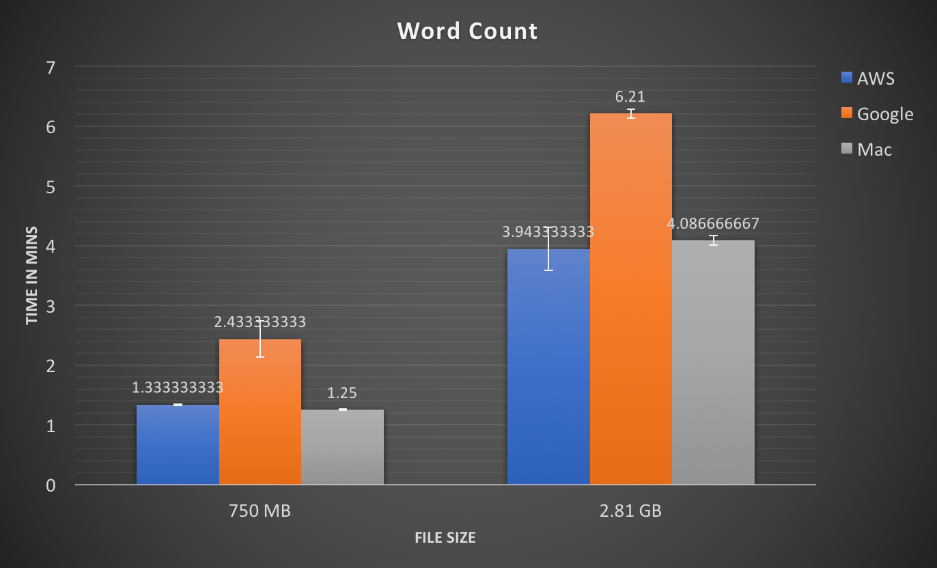

Slide 35
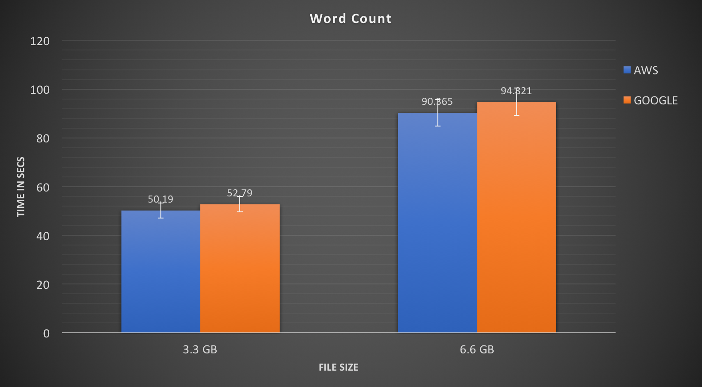
Cluster
Cluster

Slide 36
TECHNICAL CHALLENGES
Namenode enters into safemode when there is shortage of memory. As a result the HDFS becomes readable only. That means one can not create any additional directory or file in the HDFS.
To setup a multinode cluster of Hadoop in cloud platform is a challenging task

Slide 37
Conclusion
Cost Analysis as per our configuration:
If a Terasort in Amazon is completed in 4.22 mins and if the task is continuously run for 20 times the total time is 84.4 mins and the cost would be $17.724
If a Terasort in Google is completed in 7.12 mins and if the task is continuously run for 20 times the total time is 142.4 mins and the cost would be $18.93
When we compare aws and google cloud we see slight performance efficiency in aws (Signle node)
When we compare Amazon EMR and Google DataProc, Amazon EMR has better performance overall with cost. (with our testing configurations)

Slide 38
References
http://ieeexplore.ieee.org/abstract/document/6787290/
http://www.michael-noll.com/blog/2011/04/09/benchmarking-and-stress-testing-an-hadoop-cluster-with-terasort-testdfsio-nnbench-mrbench/
http://www.informit.com/articles/article.aspx?p=2453563&seqNum=2
https://discuss.pivotal.io/hc/en-us/articles/200864057-Running-DFSIO-MapReduce-benchmark-test

Slide 39
Thank You

